Slide 1
You can choose to install the XDJ-XZ mapping with or without BOME.
TO INSTALL WITH BOME:
See the installation video https://youtu.be/MbGP_ECnWiQ
Follow the DDJ-1000 installation guide PDF
Then see the XDJ-XZ specific instructions on Page 45
WHAT WILL YOU GAIN?
Jog screens
All traktor MacroFX and MixerFX
(these are in addition to Pioneer SoundColorFX Hardware effects)
Any future updates to this mapping

Slide 2
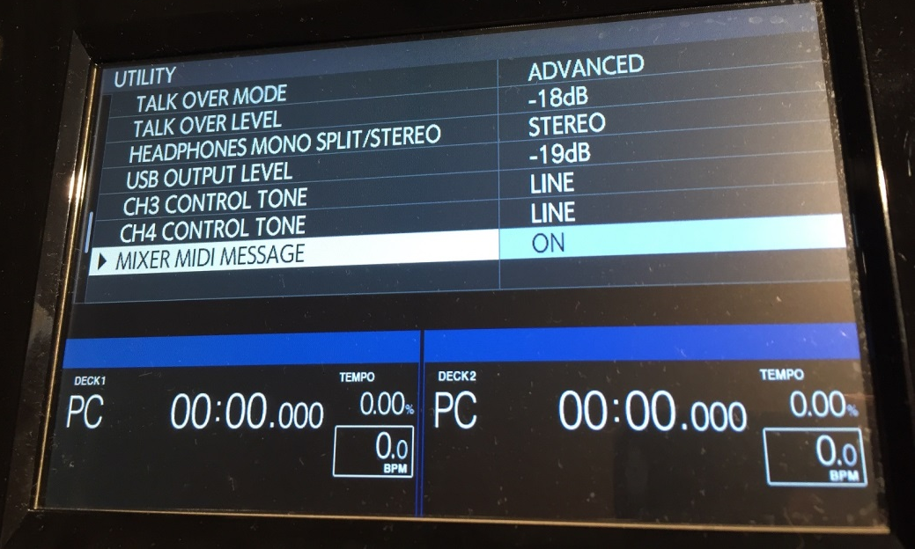
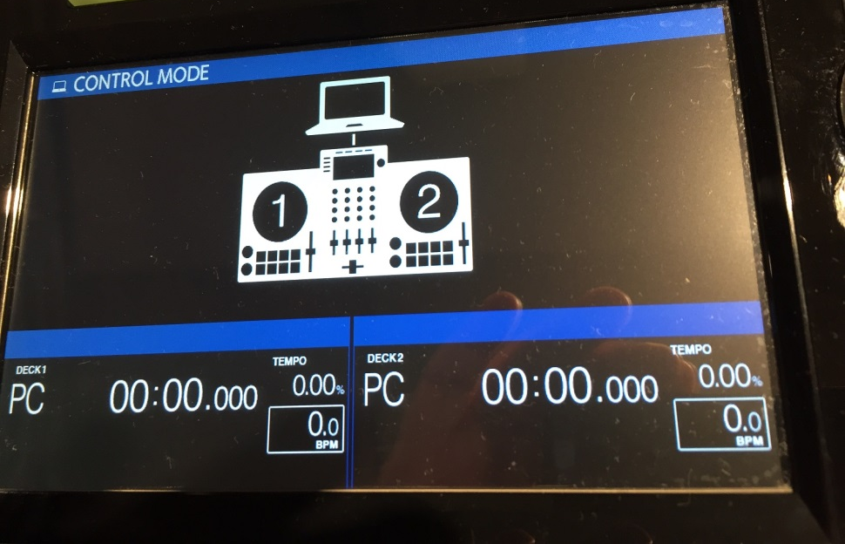
XDJ Config:
More info: See page 128 of the Pioneer Manual: https://github.com/pestrela/music/blob/master/ddj/4%20Manuals/XDJ-XZ%20-%20Full%20Manual.pdf
XDJ-XZ features video: https://www.youtube.com/watch?v=7EPfY9bGGlw&list=PLIlvTGzSxI0UV1oJfRDL4fYY9oRyLkBik&index=1
BOME installation video: https://youtu.be/MbGP_ECnWiQ

Slide 3
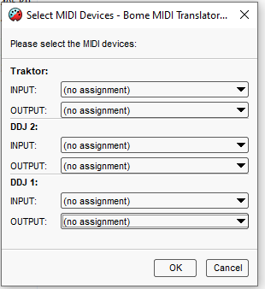
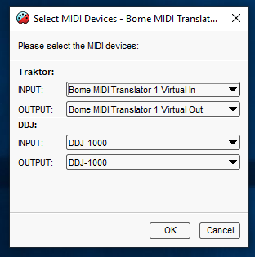
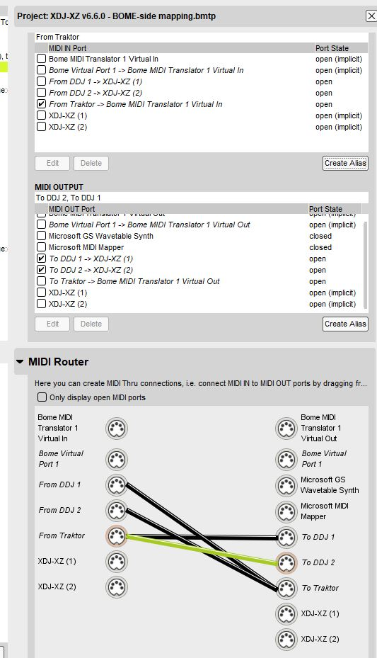
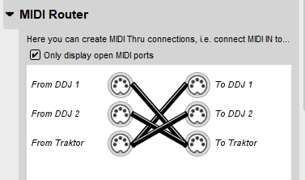
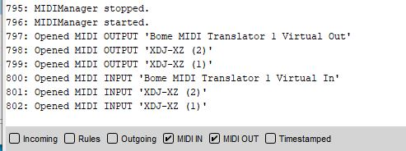
BOME aliases:
XDJ-XZ (1)
XDJ-XZ (1)
XDJ-XZ (2)
XDJ-XZ (2)
Proper BOME config:
Proper BOME config:
Proper BOME log:

Slide 4
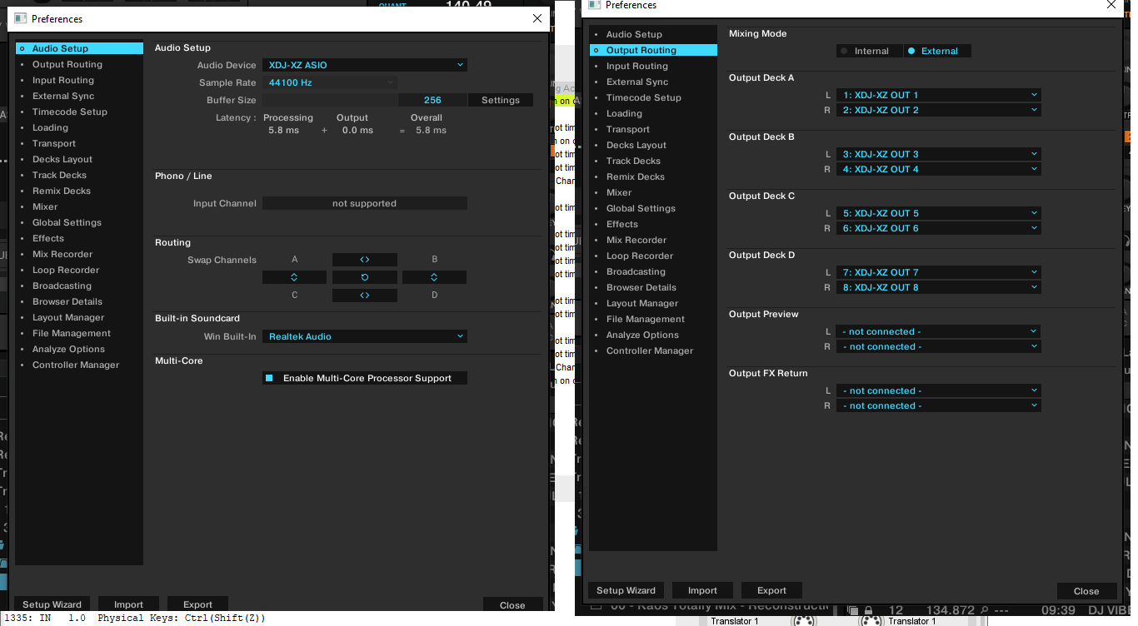
Traktor config:

Slide 5
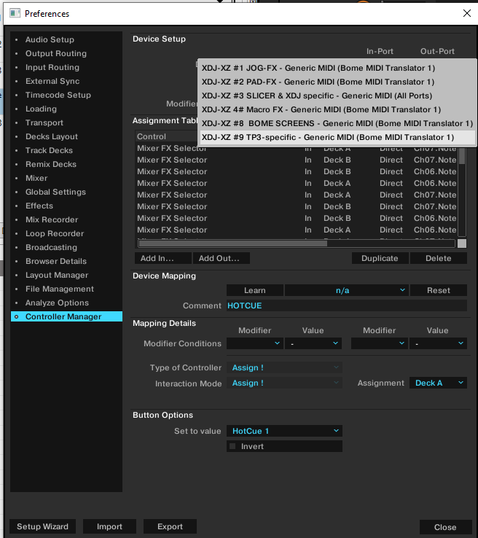
DO NOT put XDJ-XZ here!!!!

